Slide 1
DS501 Project 3 What can we predict from your choice of ride?
Mia Barger ▪ Quincy Hershey ▪ Alexander Moore ▪ Ethan Prihar

Slide 2
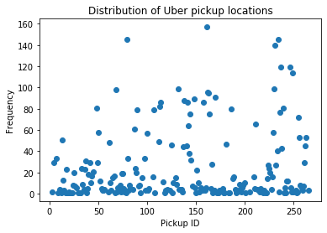
Data Exploration
Notes:
Distribution of uber trips by location ID

Slide 3
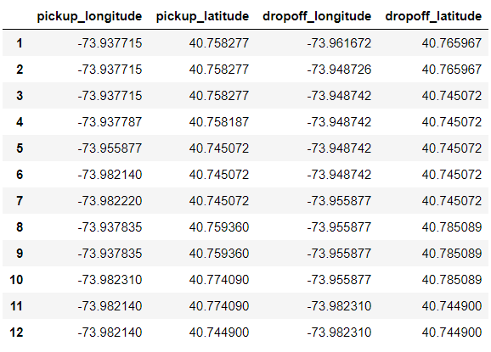
Data Exploration
Notes:
Dropped any rows with zeroes in the coordinates
This ended up removing airports and large businesses from the data, perhaps due to the data recording processes of the taxi companies

Slide 4
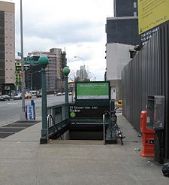
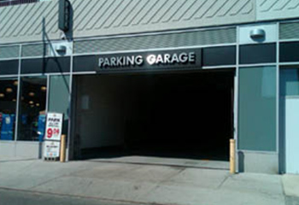
What are the most common locations?
March, April, may, June drop off:
May pick up, July drop off:
https://upload.wikimedia.org/wikipedia/commons/thumb/5/57/21alstindstair.jpg/338px-21alstindstair.jpg
https://www.parknsave.com/Documents/LocationImages/tmpAB16.jpg
Notes:
March, April, May, June drop off: Van Alst Station, on 21st Street.
May pick up, July drop off: 47th street garage
Other locations include: areas near bus stops, and the NoMad neighborhood—a popular neighborhood for tourists to stay in hotels and explore.

